Slide 1
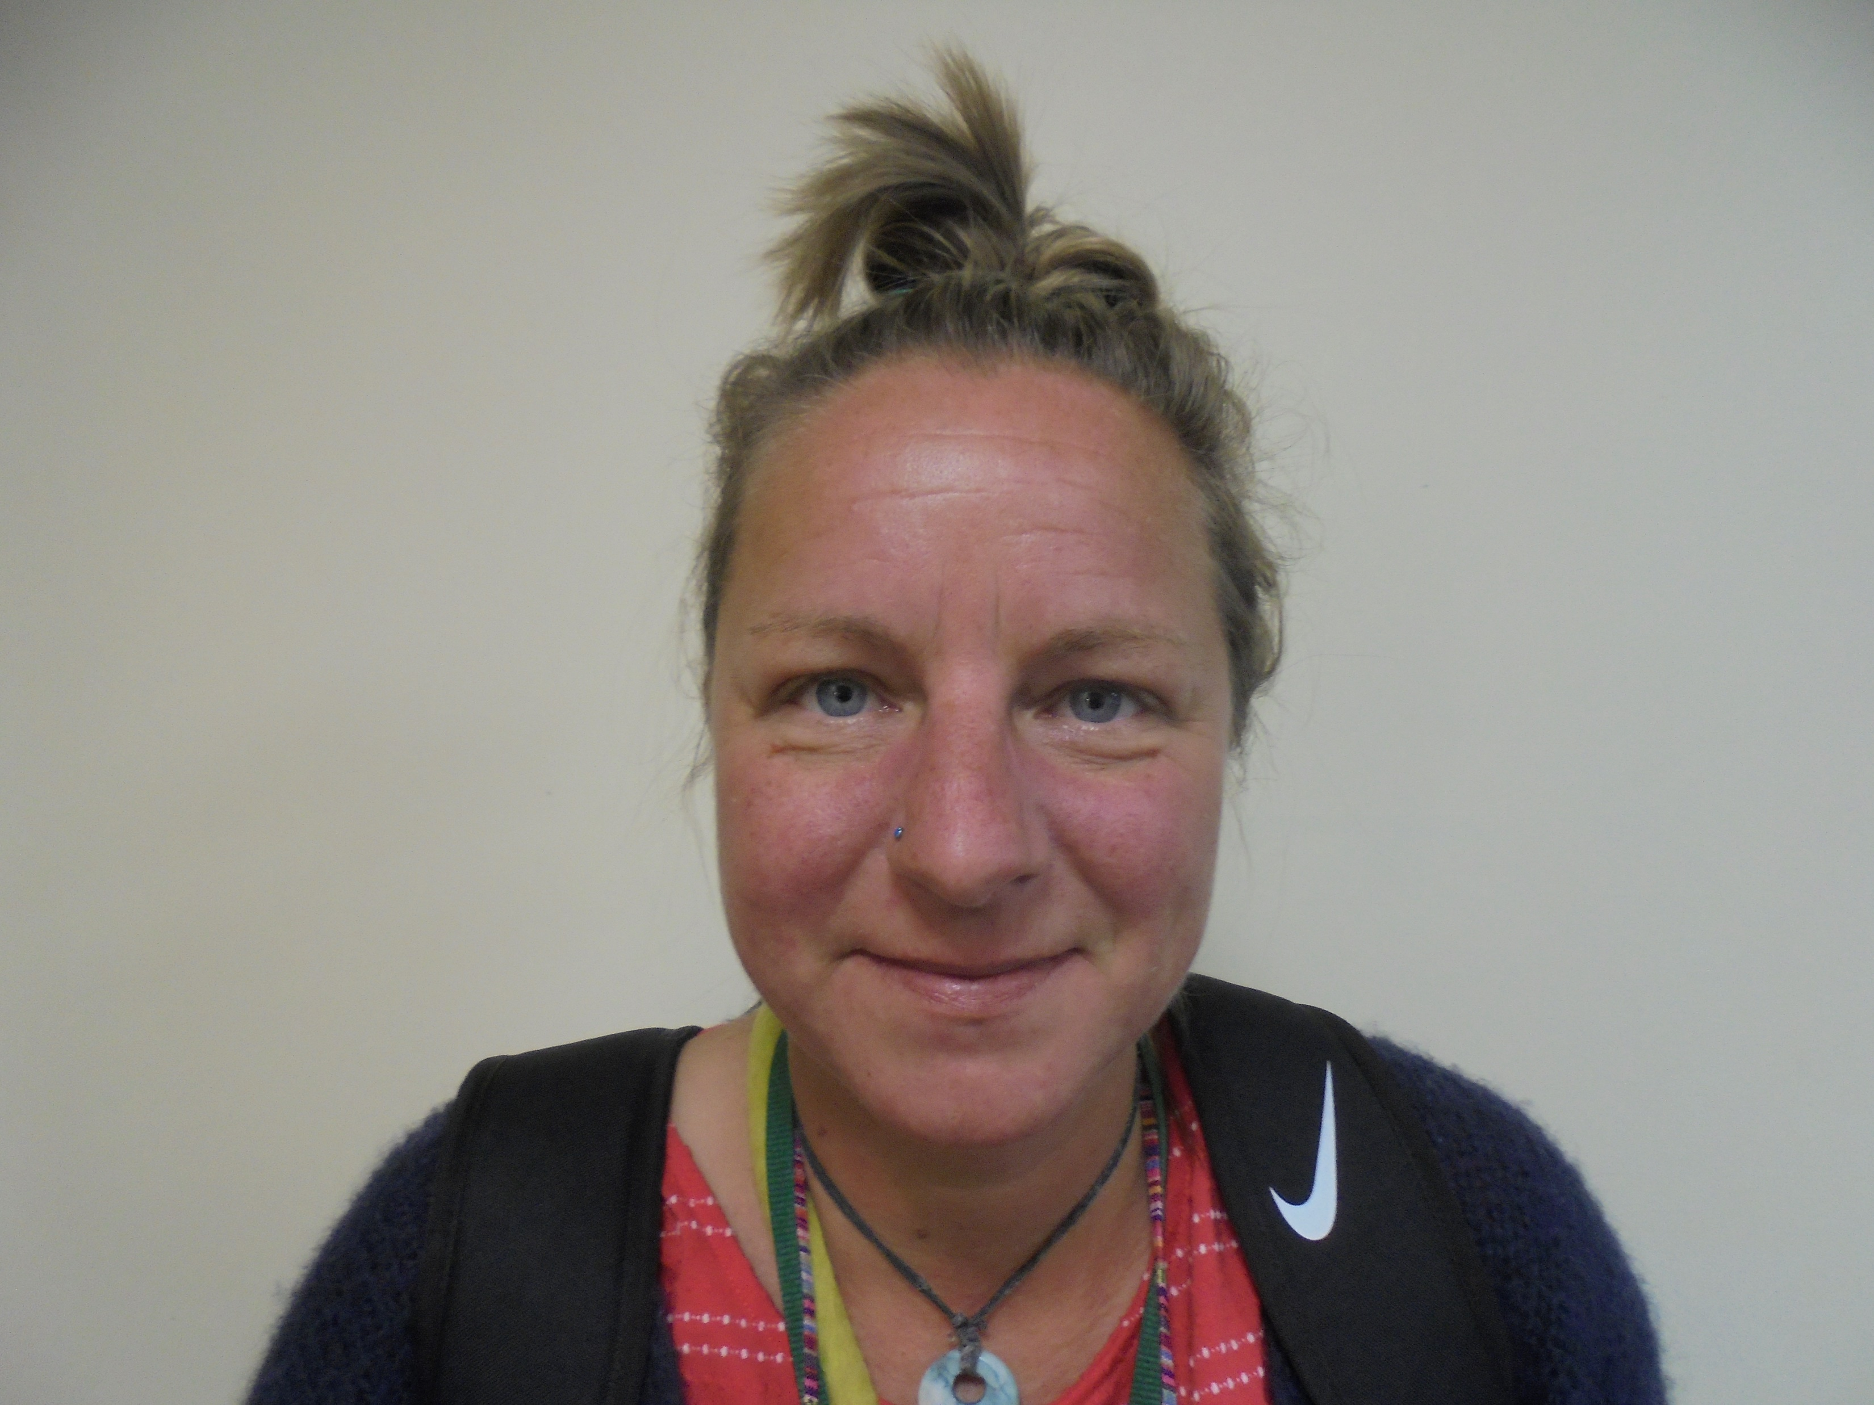
Welcome to the ‘Enrichment & Enhancement’ programme noticeboard
Miss Bailey

Slide 2
Bring a packed lunch
Mondays at Lunchtime
All Years Welcome
Room – E4
Mrs Butcher

Slide 3
Basketball
Turn up and play!
Mondays After school
These sessions will be delivered by a qualified coach from Shrewsbury Storm Basketball Club
(Year 7, 8 & 9 (Girls & Boys)
Sports Hall

Slide 4
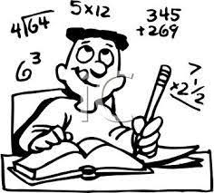
Homework Club Tuesdays & Thursdays After school All Years welcome Room - PLC
Homework Club
Relaxed Learning Space

Slide 5
Netball
Tuesdays After school
All years welcome

Slide 6
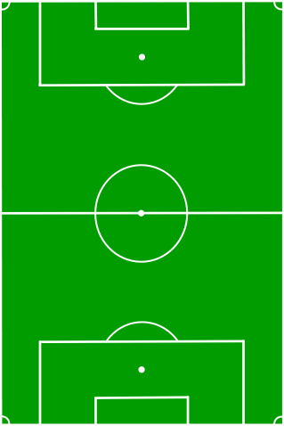
Boys Football
After school
Tuesdays – Year 7
Wednesdays – Year 8
Thursdays – Year 9

Slide 7
Homework Club Thursdays at Lunchtime For Years 10 & 11 Room - PLC
Well-Being Club
Drop In

Slide 8
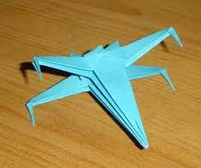
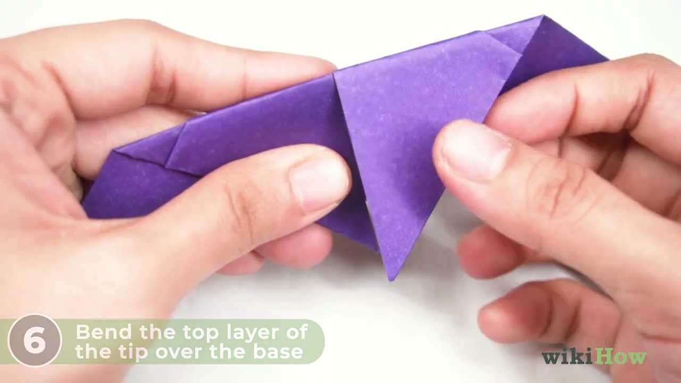
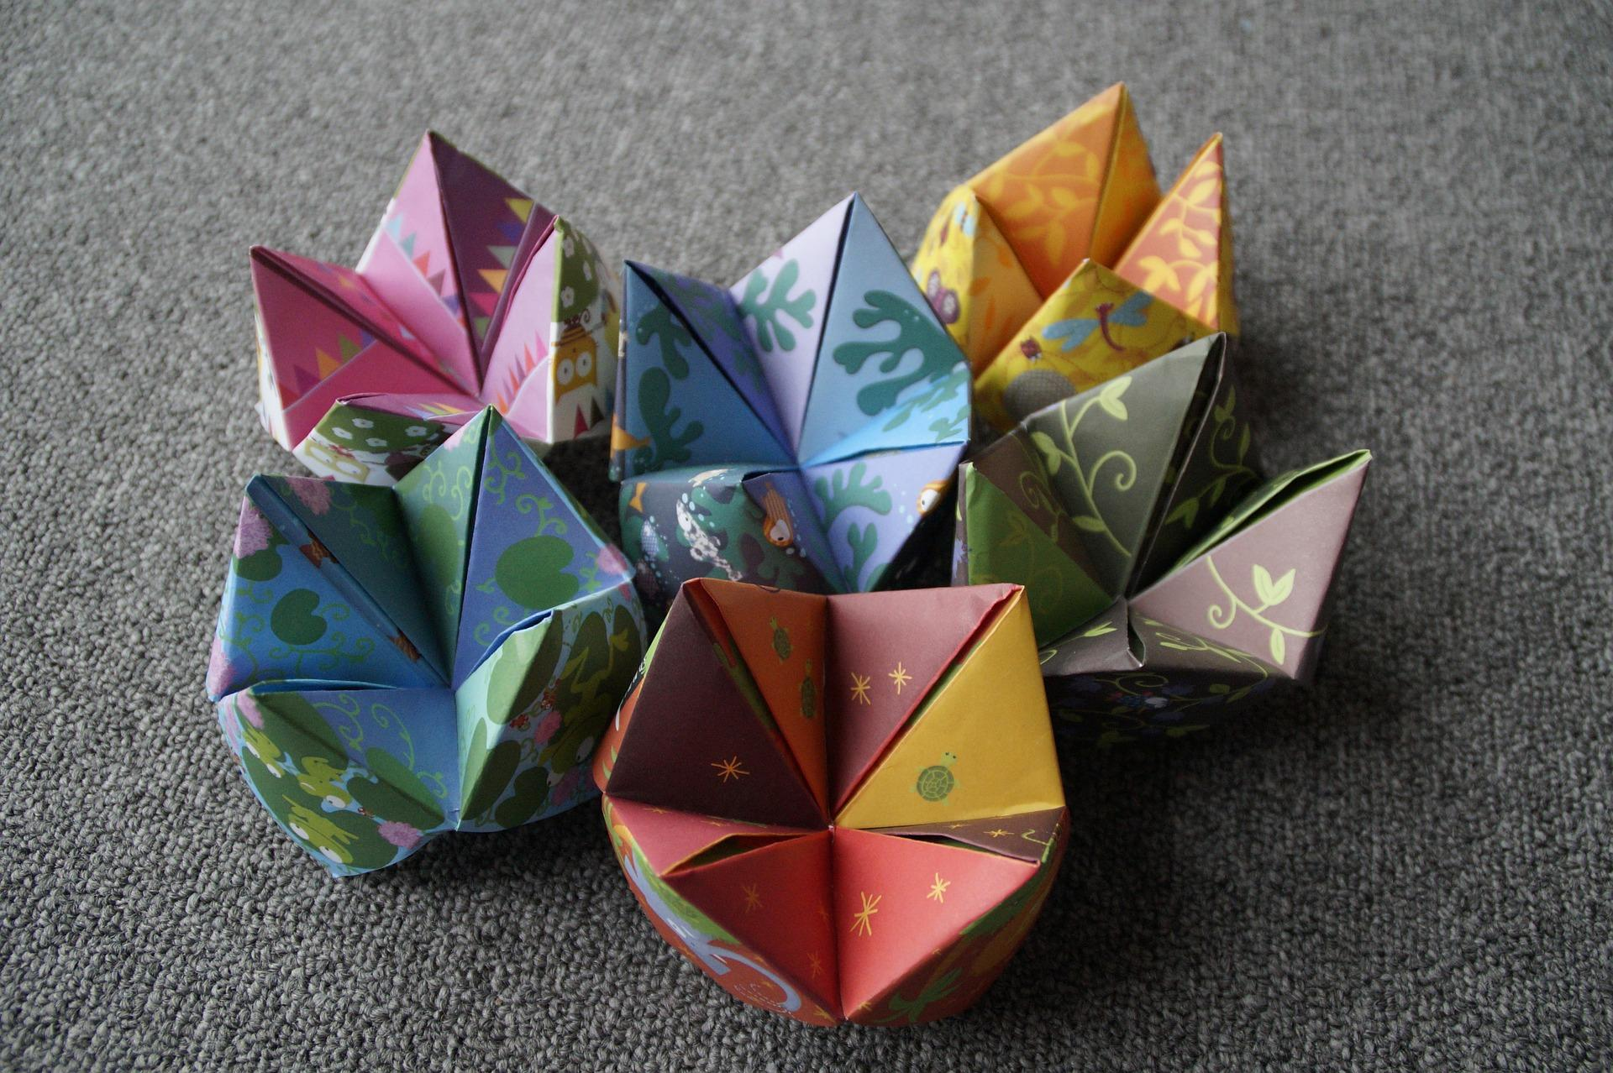
Thursdays at Lunchtime Years 7 & 8 in Room M5
Origami Club

Slide 9
Gardening Club
Coming Soon!

Slide 10
Craft Club
Wednesdays – Year 10 & 11
Thursdays - Year 7,8 & 9
Lunchtimes
Room – PLC

Slide 11
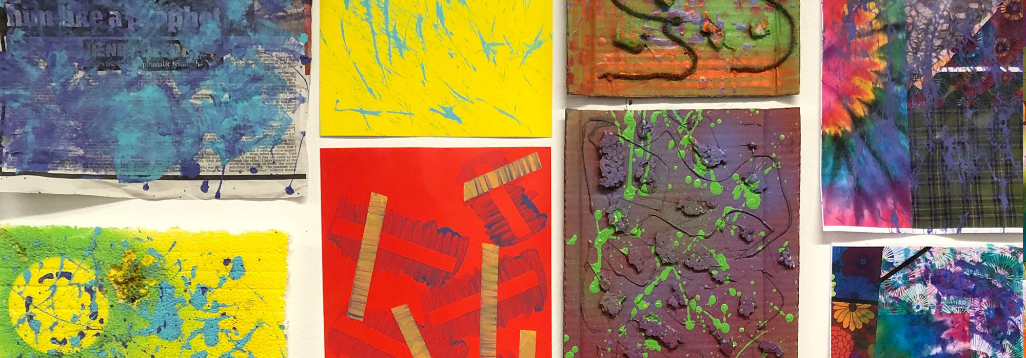
Wednesdays After school Year 10 & 11
Art / Design & Technology Support
Art /Tech Rooms

Slide 12
Thursdays at Lunchtime Open to everyone! Room - Meeting Room (next to Languages office)
Careers Drop in
Drop In

Slide 13
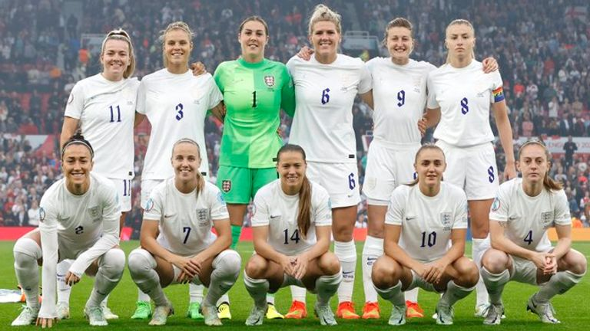
Girls Football
in partnership with Worthen Juniors FC
Thursdays After school
All Years Welcome
on Astro

Slide 14
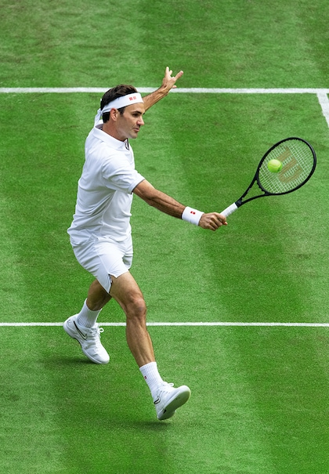
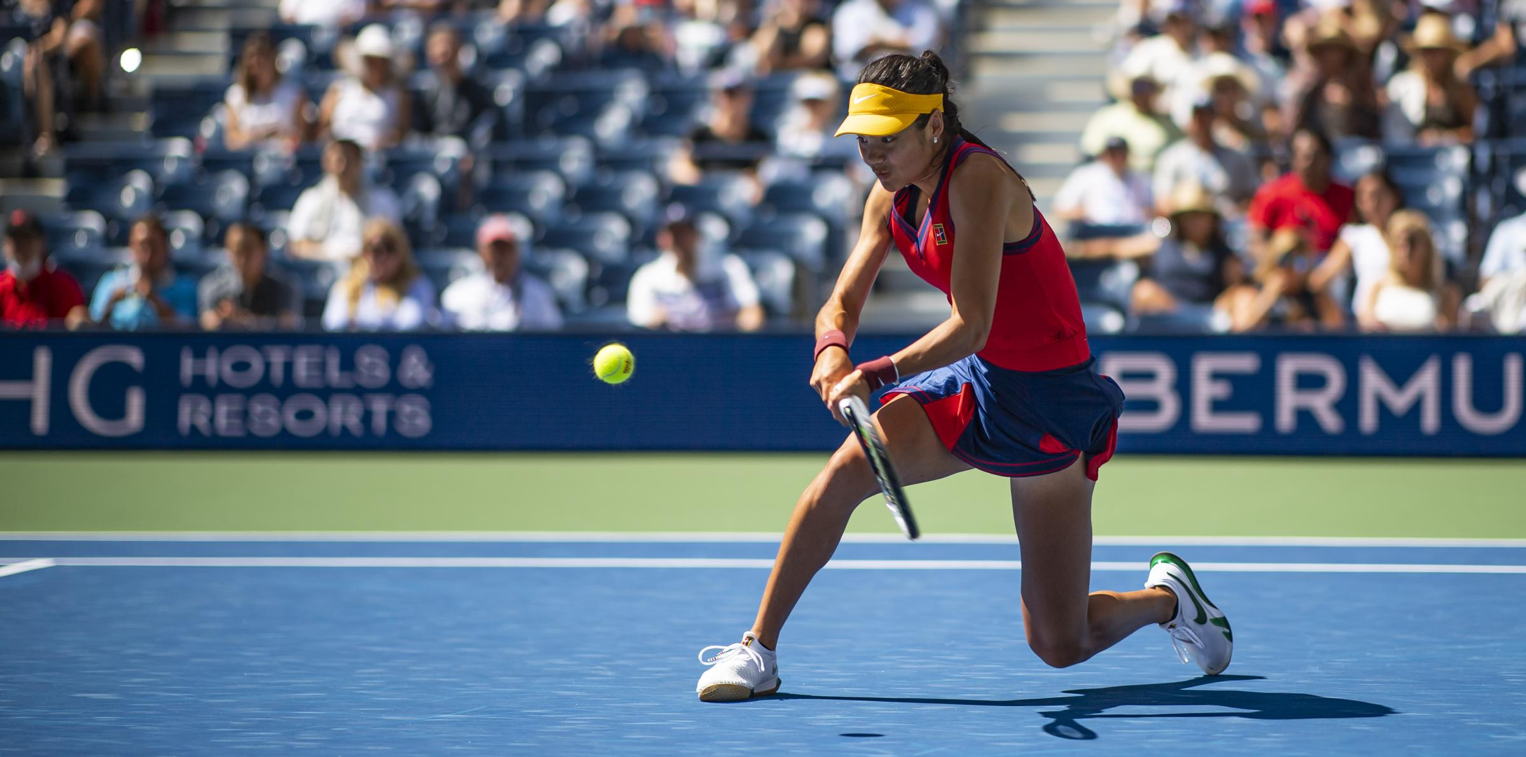
Tennis
Thursdays After school
3:30 – 4:30pm
Places are limited (12 places)
First come first serve.
Sign up by adding your name on the sheet in PE Dept - Staff room door
Sessions will be ran by qualified Tennis Coach, Sam Leigh
Please bring your own racket

Slide 15
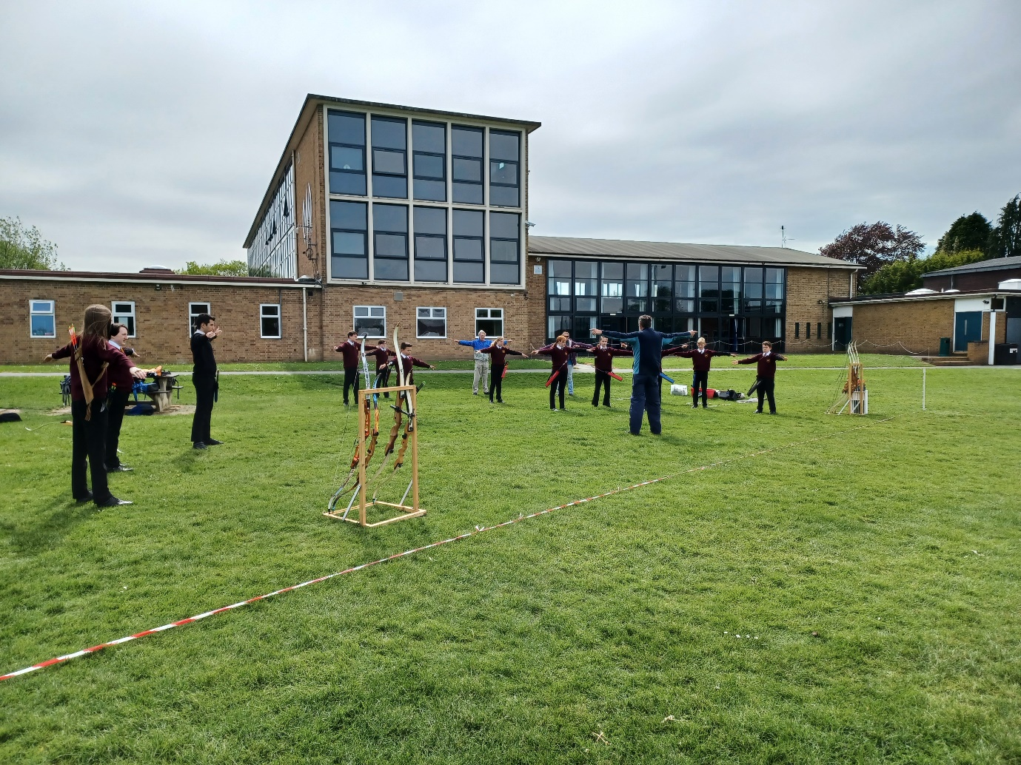
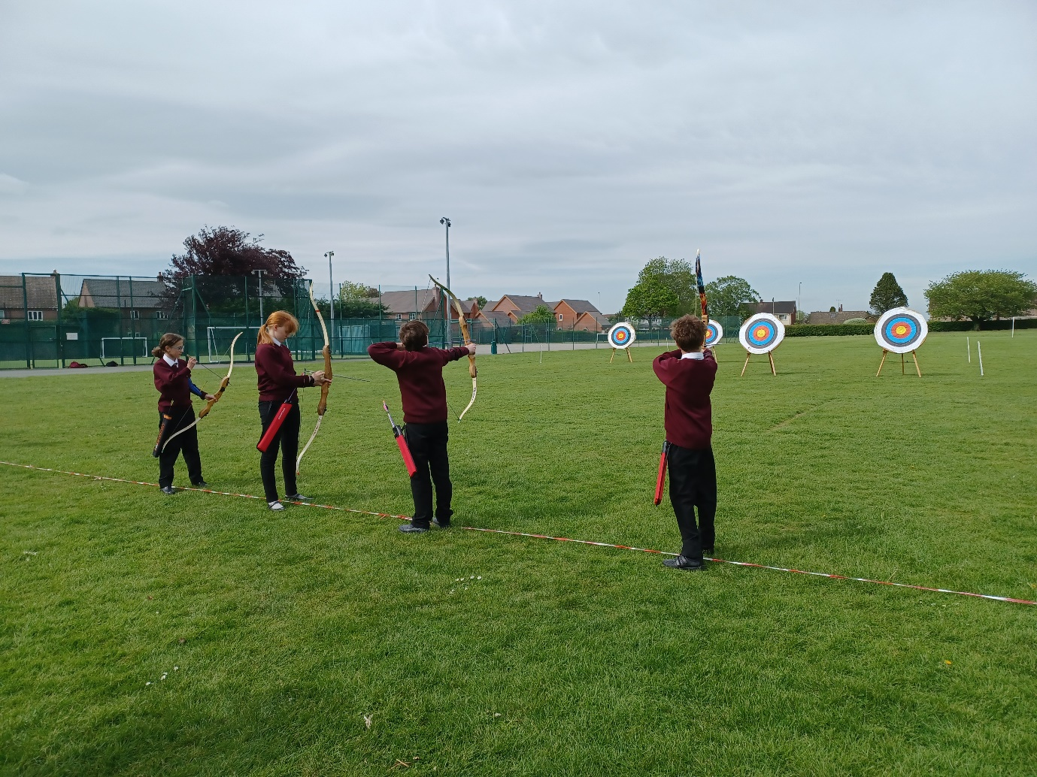
Friday after school All Years 3:15 – 4:15pm Field
Archery
– limited spaces available

Slide 16
Thursdays After school All Years welcome
Music – Webb Rock
Music Room

Slide 17
PE Activities
Day | Activity | Year | Time | Location
Monday | Basketball | 7,8 & 9 | 3:15 – 4:15 | Sports Hall
Tuesday | Football (Boys) | Year 7 | 3:15 – 4:15 | Astro
 | Netball | All years | 3:15 – 4:15 | PE Dept
Wednesday | Football (Boys) | Year 8 | 3:15 – 4:15 | PE Dept
Thursday | Football (Girls) | All Years | 3:15 – 4:15 | Astro
 | Tennis | All Year (First Come First Serve – Spaces limited) | 3:30 – 4:30pm | Sports Hall
 | Football (Boys) | Year 9 | 3:15 – 4:15 | Field
Friday | Archery | All years (Limited Spaces) | 3:15 – 4:15 | Field

Slide 18
Library –Chess Club
Thursday - Break
(All Years welcome)
Sign up in advance to guarantee you place –
places are limited!
Email: lbourne@marywebbschool.com
In the Library
Guarantee you place

Slide 19
Library - Book Club
Thursday - Break
(All Years welcome)
Sign up in advance to guarantee you place –
places are limited!
Email: lbourne@marywebbschool.com
In the Library

Slide 20
Library – Reading & Homework
Lunchtimes:
Mondays – Year 7, 9 and 11
Tuesdays – All years – QUIET DAY – Silent Reading & Homework
Wednesdays – Years 8 & 10
Thursdays – 7, 9 & 11
Fridays – Year 8 & 10
In the Library
Shhh……. Tuesdays are Quiet Days

Slide 21
Drop in Sessions
Years 7 & 8
(First Break)
Years 9, 10 & 11
(Lunchtime)
In the Dance Studio

Slide 22
Library - Book Club
Thursday - Break
(All Years welcome)
In the Library

